Slide 1
BUS PASS MANAGEMENT SYSTEM

Slide 2
ABSTRACT
A bus pass management system, will be very helpful for managing the relationship between the passengers and conductors, why because the passengers no need to take care of the bus pass entry sheet, If the passenger forget to took the pass, they no need to worry about it. Because this system will be generating. Here we have using five modules are User Registration, New bus pass registration, Renewal bus pass, Bus registration, Print or download pass. User registration module handle the user details, when user need new buss pass will be handle by the new bus pass registration, renewal bus pass can handle renewal the pass also we can able to print the bus pass in online
The main goal of this project is that reducing the man power and giving an accurate information to the passenger, the passenger can manually renewal the bus pass in online. The project is aimed to develop by JAVA as Front end and SQL as Back end.

Slide 3
Objectives
Bus pass management system web Or android applications for users get a new pass,renewel the bus pass And digital bus pass all the process thought online.

Slide 4
HARDWARE SPECFICATION
Processor : P 4 700 GHz.
RAM : 4 GB RAM
Hard Disk Drive : 180 GB

Slide 5
SOFTWARE SPECIFICATION
Operating System : Windows 7/8/10
Front End : JAVA
Back End : SQL

Slide 6
EXISTING SYSTEM
The existing system is bus pass management is very hard to manage manually. In this system passenger should take the pass anywhere we go. It may sometime chance to miss the pass. Passenger only responsible for the bus pass. This may hard to use this system which is have some drawbacks
Disadvantages
Chance for missing pass
Cheating the pass has to be possible
Renewal the pass we have to waiting a long queue

Slide 7
PROPOSED SYSTEM
This proposed system will be overcome above mentioned all kind of issue. This will help to renewal pass manually. User no need to took the pass anywhere. Just give the request and it will be showing the current user details. The conductor also finds the details of the passenger.
Advantages
Avoid pass missing issue
Renewal passes systematically by the passenger
Attractive user interface

Slide 8
Modules
Login
New Passenger Registration
New Pass Registration
Digital pass Generation
Renewal pass

Slide 9
New Registration:
This module Is used to create new user from this module. We can collect all the information about the users. Which is helpful to search or manage the user details.
New Pass Registration:
This pass registration module is used create pass to the user. After creating the pass it will be automatically generate digital pass.
Digital pass Generation:
After creating the pass registration automatically digital pass will be generated. We can show it to the conductor then he/she will check it. No need to took pass in your hand.

Slide 10
Renewal pass:
After completing the duration of pass this module will helpful to renewal pass. We no need to waiting in the queue as long time. We just login and renewal pass yourself.

Slide 11

Data Flow Diagram
Level 0:

Slide 12
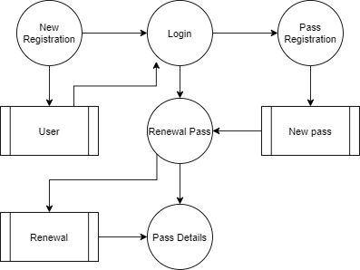
Level 1:

Slide 13
TABLE STRUCTURE

Slide 16
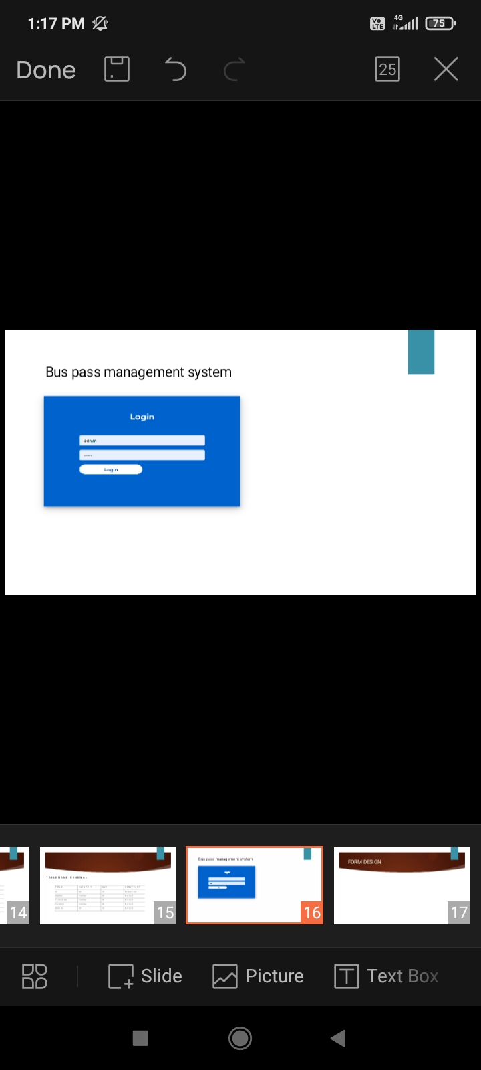
FORM DESIGN

Slide 17
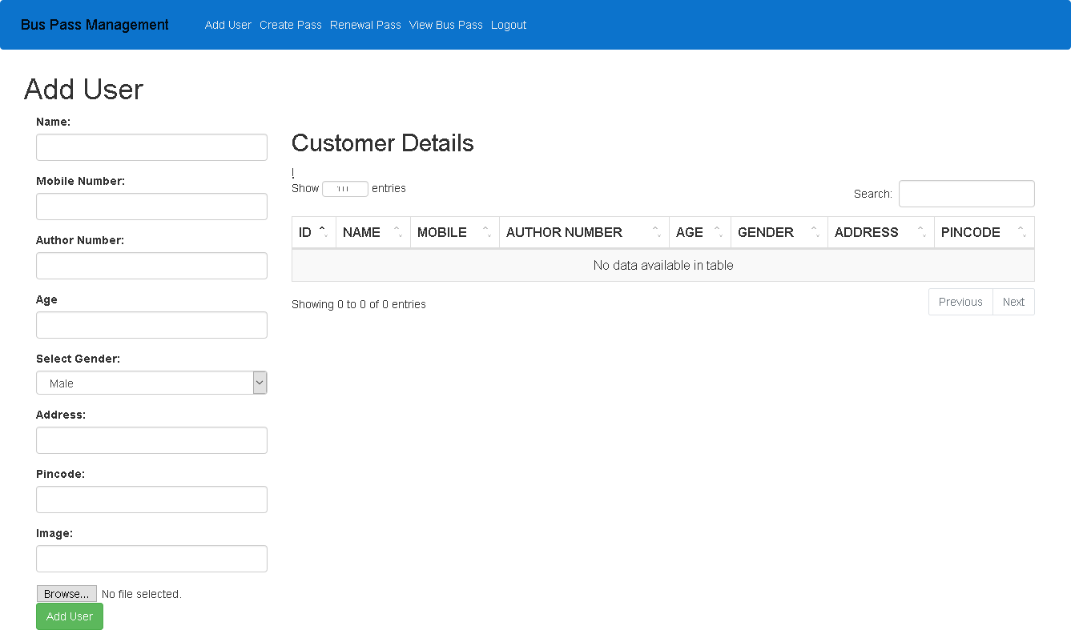

Slide 18
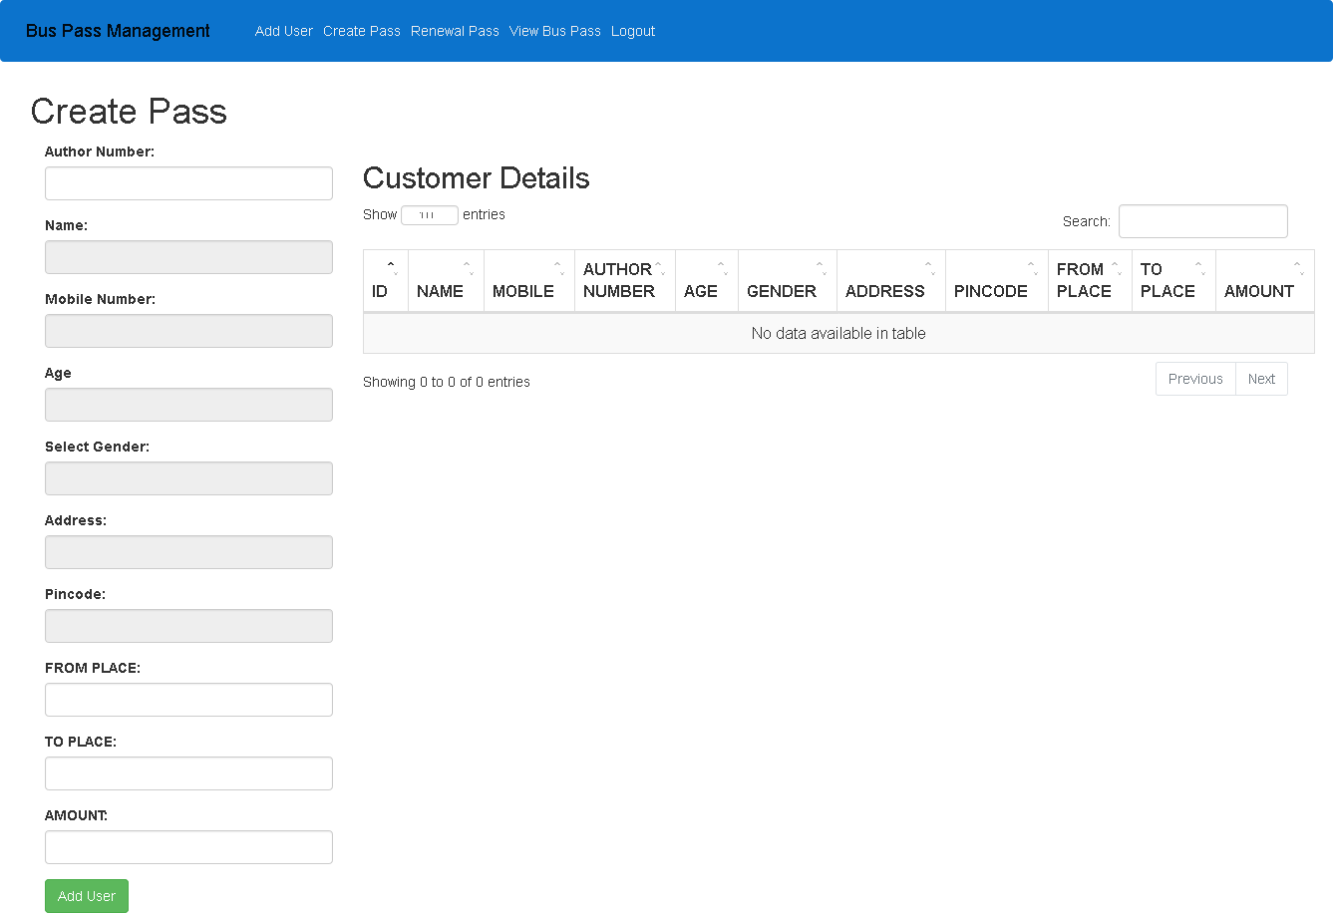

Slide 19
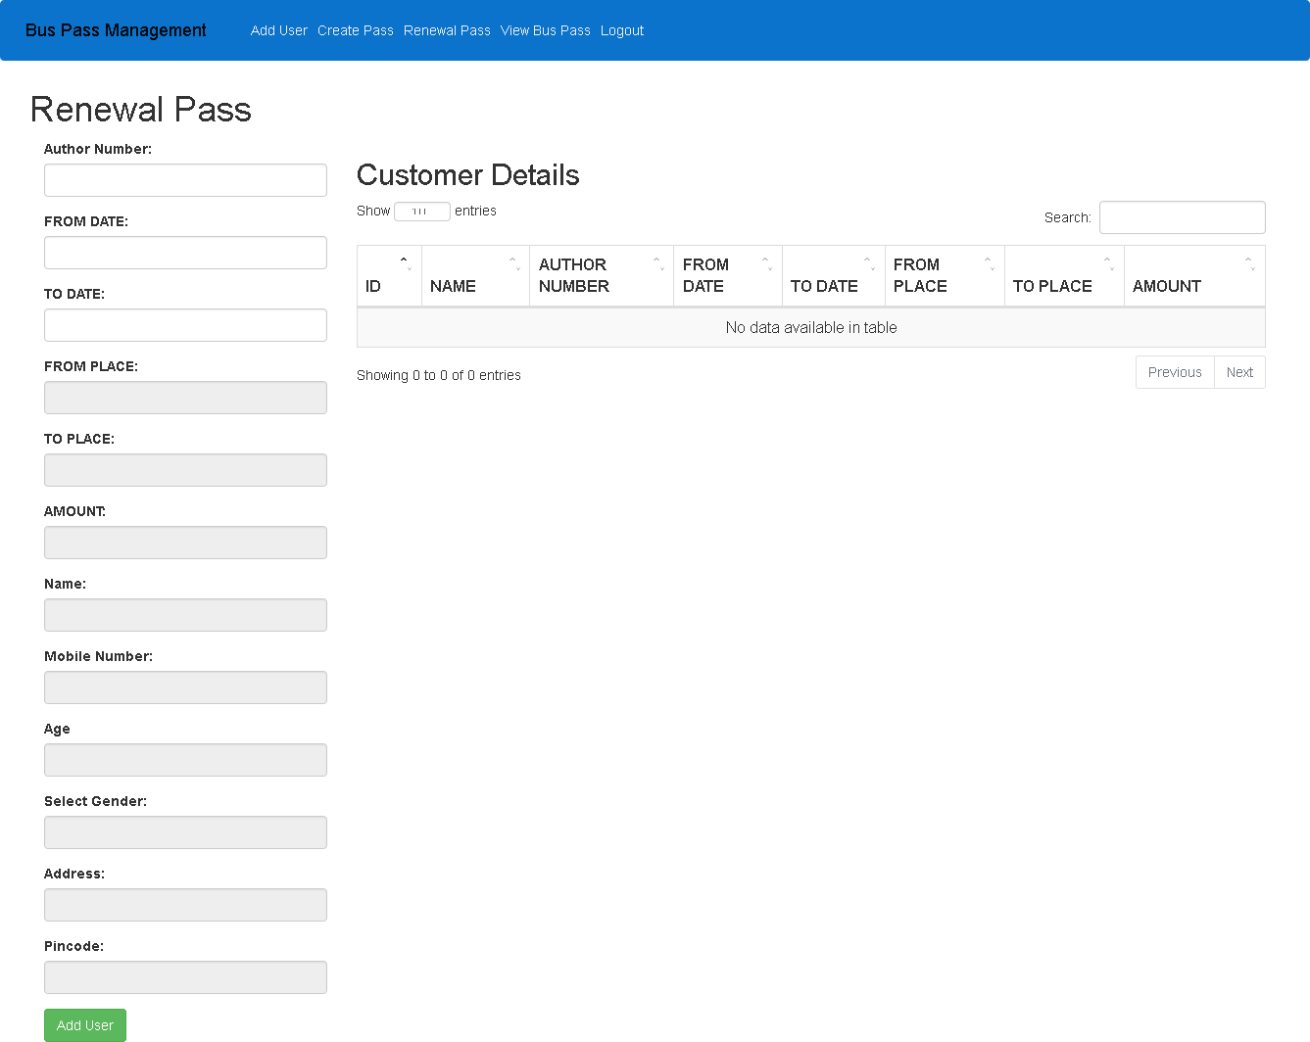

Slide 20
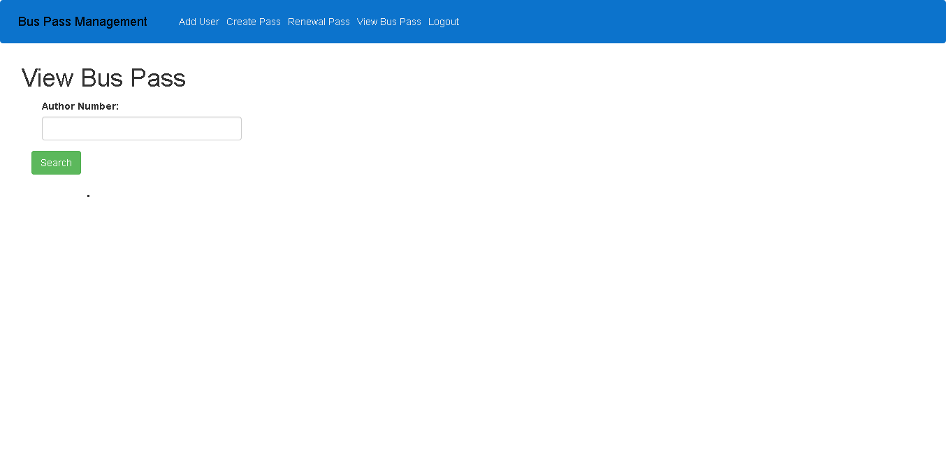

Slide 21
Thank You

